Slide 1

PHS Dashboard Project
Mandip Farmahan,
Sarah Henry,
Mark MacDonald,
Vera Shcherbina

Slide 2

Project Brief
1. To what extent are the ‘winter crises’ reported by the media real?
2. How has the Covid-19 pandemic affected provision of acute care in Scotland?
Each question approached from three different angles:
Temporal: How has this issue changed over time? (Is it getting better or worse?)
Geographic: How does this issue differ between areas in Scotland? (Where should efforts be focused?)
Demographic: Who is most affected by this issue? (Who should be targeted with efforts?)

Slide 3

Data Requirements, Sources and Ethics
The datasets were obtained from Public Health Scotland. It is a public sector information licensed under Open Government Data license 3.0.
Data was anonymized by the provider and doesn’t contain personally identifiable information, making it compliant with General Data Protection Regulation.
From ethics point of view, for the sake of the project we worked on data minimisation. Only cleaned and necessary data has been uploaded to GitHub.
Notes:
The datasets were obtained from Public Health Scotland. It is a public sector information licensed under Open Government Data license 3.0. PHS open data datasets also meet the requirements set out in the Scottish Government Open Data Strategy (2015).
Data is provided from the period from 3rd quarter of 2017 to 3rd quarter of 2022, confirming its timeliness for comparing pre-Covid, Covid and post-Covid periods.
Data was anonymized by the provider and doesn’t contain personally identifiable information, making it compliant with General Data Protection Regulation.
From ethics point of view, for the sake of the project we worked on data minimisation. Only cleaned and necessary data has been uploaded to GitHub, aiming to decrease:
the volume of data;
its potential misuse;
environmental factors (carbon offset created by processing the data).
From the security point of view, all data stored on personal computers will be deleted immediately after the end of the project.

Slide 4
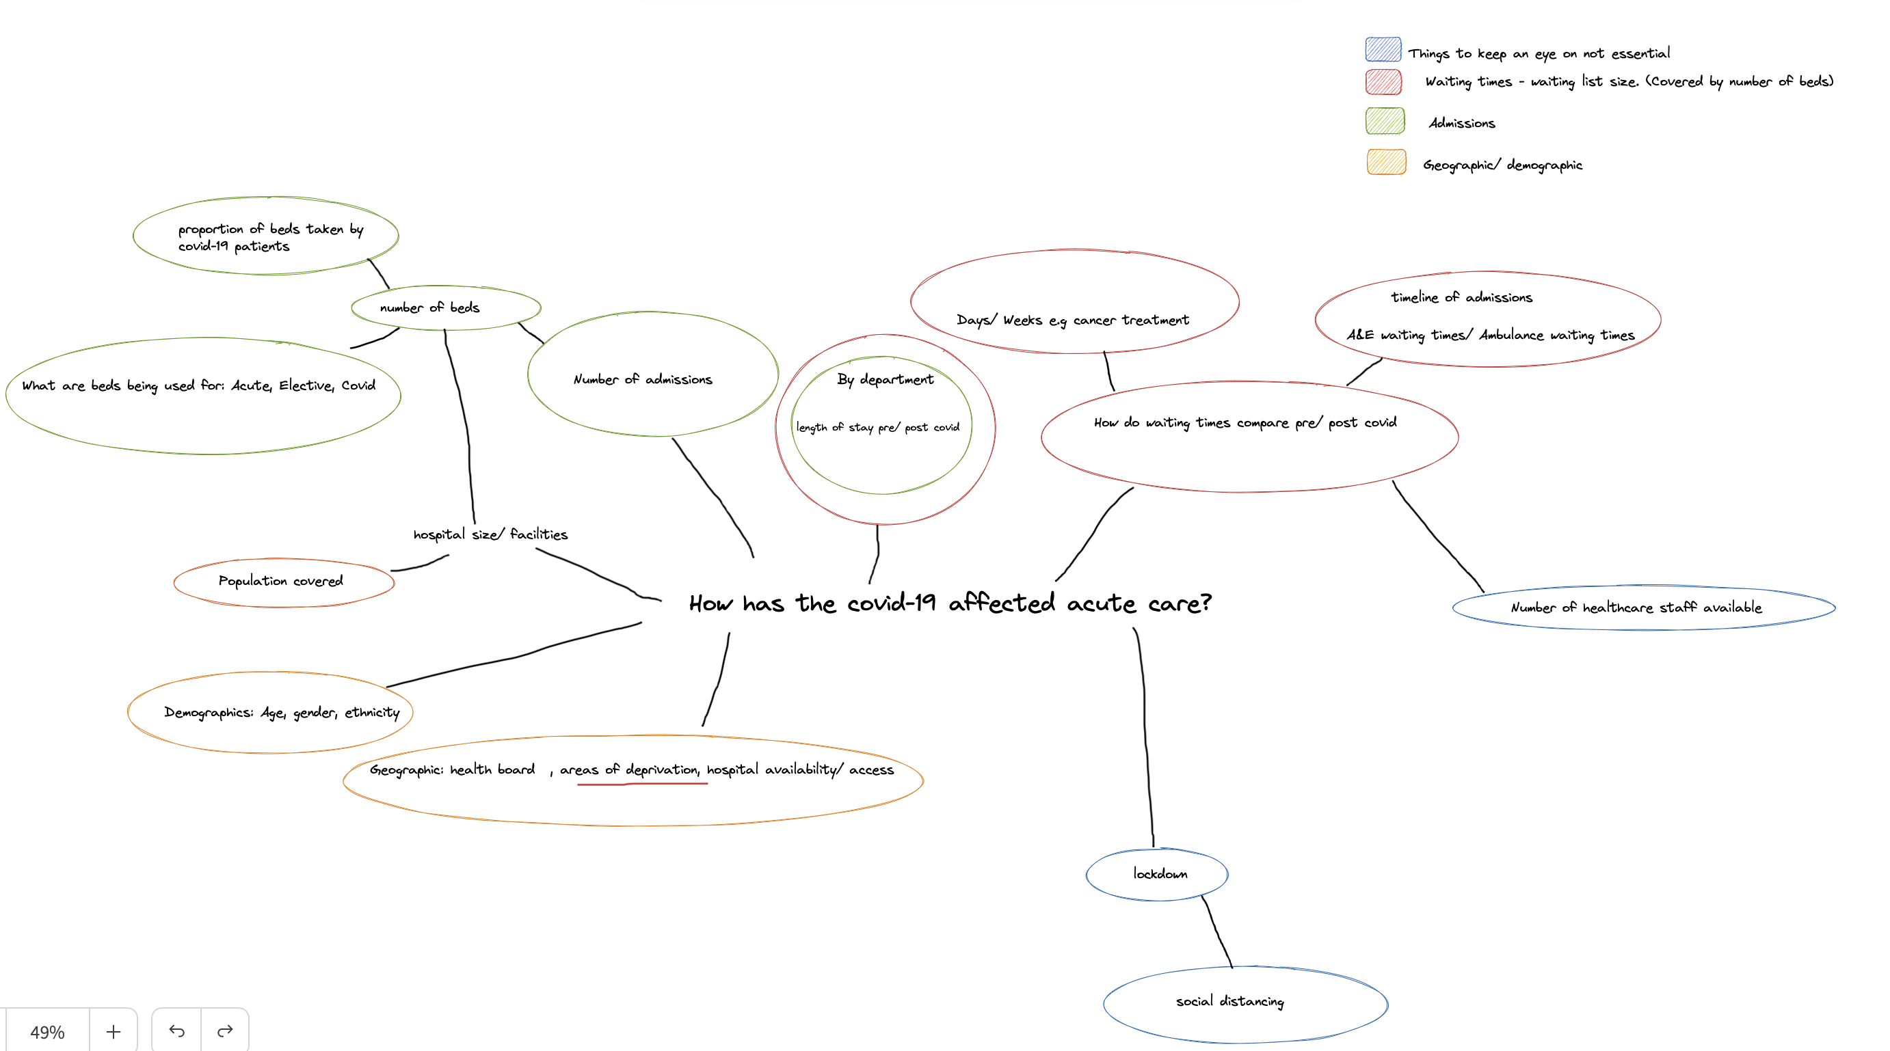






Defining Project Requirements

Slide 5

KPI and Framework
KPI’s
Number of episodes in different seasons
Length of stay in the hospital in different seasons
Proportion of occupied beds
These were analysed under the following categories:
A&E;
Age & Sex;
Health boards;
Index of deprivation;
Medical specialty

Slide 6
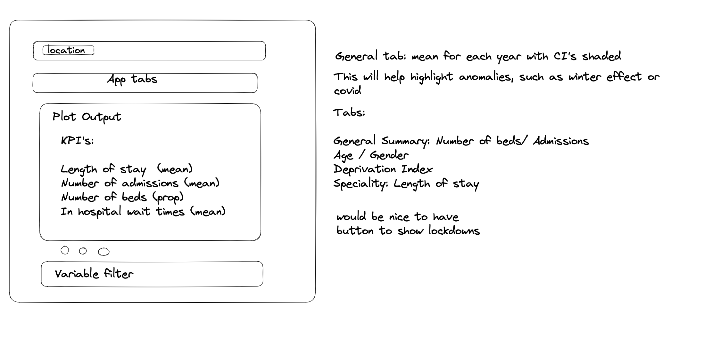
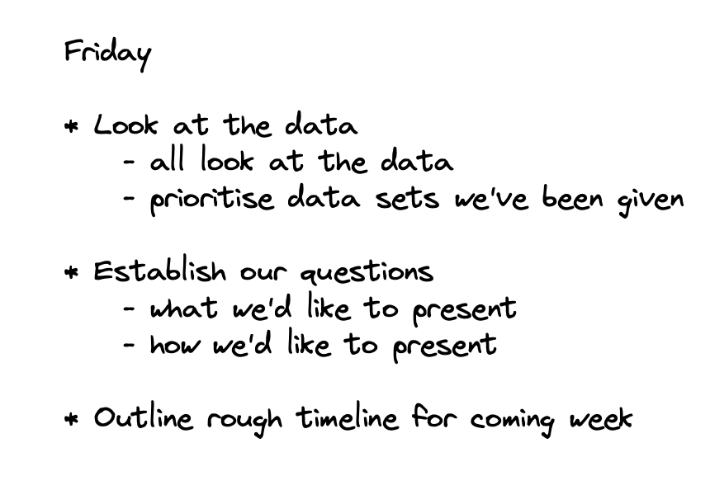
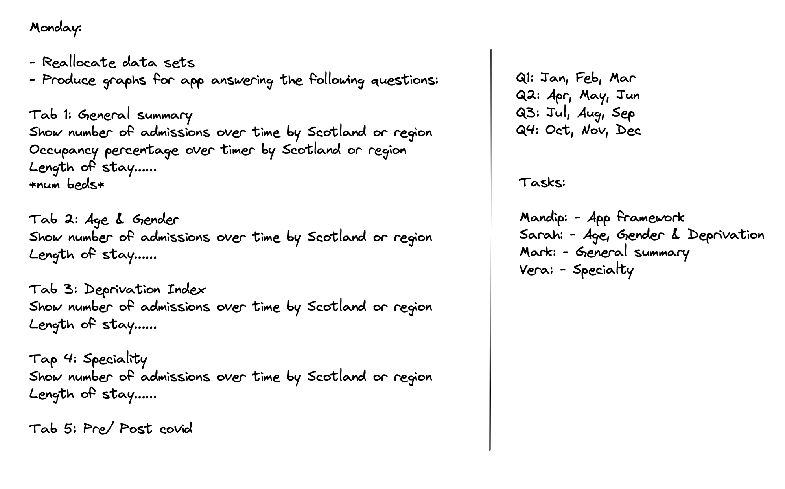
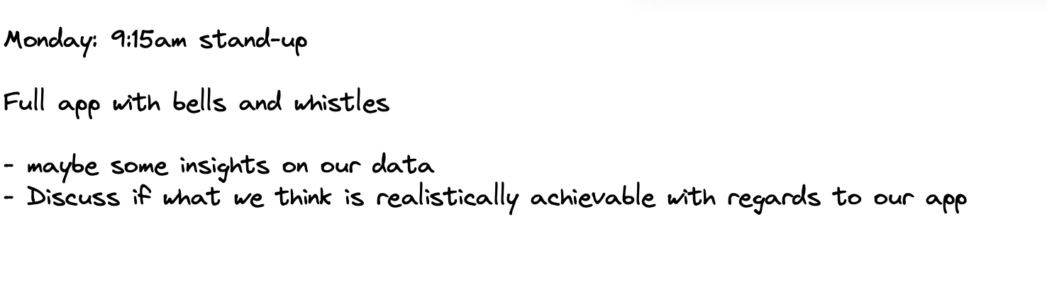
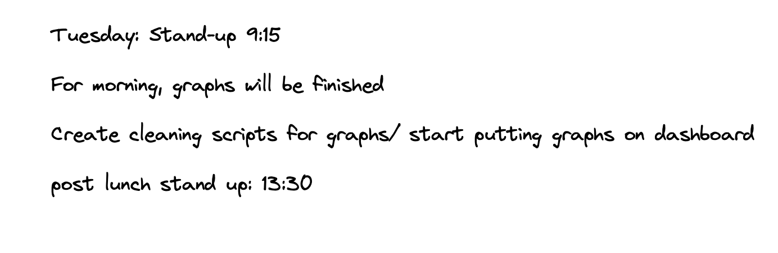
Project Planning

Slide 7
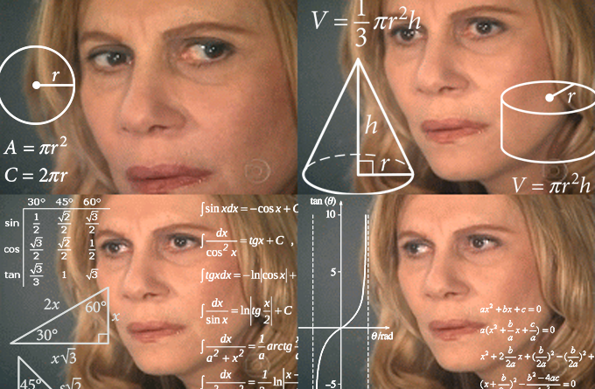
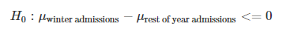
Is There a Winter Effect?
Are the A&E admissions higher in winter higher than in the rest of the year?
Are A&E winter admission rates different pre-covid and post-covid?
Are the proportions of A&E patients discharged home different in winter compared to rest of year

Slide 8

Winter Findings
Reduction in number of A&E admissions in winter compared to the rest of the year
Reduction in number of A&E admissions in winter compared to the rest of the year before and after covid
There was a difference in the proportions of people sent home. In summer more people were sent home, compared to winter when patients were more likely to be kept in hospital

Slide 9

Conclusions
To what extent are the ‘winter crises’ reported by the media real?
Trends indicate that there are similar A&E admissions, however a lower percentage are immediately discharged.
How has the Covid-19 pandemic affected provision of acute care in Scotland?
Trends indicated that there was a drop in admissions during the 2020 lockdown but they are steadily rising back to pre-covid levels

